Slide 1
Language and Food
October 28, 2016

Slide 2
Potlatch Fund Trainers/Staff
Tachini Pete (Salish/Dine), MBA
Capacity Building Program Director
Provides training and technical assistance services
Specializes in language revitalization, second language acquisition, and small business development
Former Executive Director of Nkwusm, Salish Language Revitalization Institute
Author of Salish Language Dictionary
Small Business owner (Tachini Drums)

Slide 3
About Potlatch Fund

Slide 4
Our History
Potlatch Fund was started in 2002. Our mission is to build upon the Native tradition of giving and to expand philanthropy in Native and Tribal communities in the Pacific Northwest (WA, OR, ID, MT).
Since then, Potlatch Fund has
Conducted over 228 training workshops
Graduated 42 emerging leaders
Distributed more than $3 million in grants
Honored 28 individuals and organizations for leadership and philanthropy
Notes:
Potlatch Fund is a Native-led foundation that provides grants, capacity building training and leadership development opportunities to Native communities throughout the states of Washington, Oregon, Idaho and Montana. Our work takes us across the Pacific Northwest where we, repeatedly, witness the harsh reality that many of the non-governmental services taken for granted in mainstream communities are unavailable in Indian Country.
Our mission is to inspire and build upon the Native tradition of giving and to expand philanthropy within Tribal Nations and Native communities in the Northwest
Our Values
We recognize and respect the sovereign status of Tribes.
We recognize that Potlatch Fund has a role in supporting and complementing the work of Tribal governments and Tribal and community initiatives.
We honor elders, children and future generations.
We aim to honor, enrich, share and protect traditions, culture and the natural world.
We take an asset based approach to community development.
We are respectful of all peoples that we work with.
We have a commitment to educating non-Native communities about Indian Country.
We are both innovative and aspire for excellence in all that we do.
We believe that philanthropy and Potlatches are essential tools for community wellbeing

Slide 5
What We Do
Founded in 2002, Potlatch Fund aims to inspire and build upon the Native tradition of giving and to expand philanthropy into Tribal Nations and Native Communities in the Northwest.
Grantmaking
Nonprofit Development
Inspiring Philanthropy

Slide 6
Language and Food

Slide 7
Language shapes our worldview & perceptions
Language is the heart of culture.
When we speak we project or express a worldview unique to our language
English has a philosophical foundation partly rooted in chance or luck
Things are viewed as random occurrence allowing for a separation of cause and effect

Slide 8
Language shapes our worldview & perceptions
Salish has a philosophical foundation in relationship
Relationship to place
Relationship to time
Relationship to each other
It is perspective based.
When people speak, you automatically know how one perceives their relationship to their surroundings

Slide 9
Language shapes our worldview & perceptions
A central concept of Salish is harmony and balance
The root word /pu/, a philosophical foundation of Salish, means harmony and balance.
The word for heart, spuus, can be translated as the origin of /pu/, or harmony and balance
s-pu-us = Nominalizer-harmony-origin

Slide 10
Language shapes our worldview & perceptions
The word for respect in Salish is putʔem. Loosely deconstructed is means, being in the state of balance in the here and now.
pu-t-ʔe-m = harmony-stative-locative.here.now-passive
puʔ- as a prefix indicate spouse of significant other. I believe it is indicative of balance of relationship or partnership.
puʔTachini would be in reference to my spouse or significant other and vice versa.

Slide 11
Language and Food

Slide 12
How language and worldview impacts food and food sovereignty
Language shapes how we perceive and talk about food and food preparation.
In Salish skʷalulexʷ is the word for plants
This word literally means “that which grows in the earth/ground”
Every time you speak of a plant in general, the image of growth in the soil is conjured in the mind.
The root of a plant is soxʷep which means “the outward stretched from the base”

Slide 13
How language and worldview impacts food and food sovereignty
Language shapes how we perceive and talk about food and food preparation.
Water is a very important and special substance in the Salish worldview
In Salish sewɬkʷ is water
It literally means ‘the ask liquid’
It is in reference to the importance placed on water. The prayers and thanks offered to every use of water.

Slide 14
How language and worldview impacts food and food sovereignty
Classification of foods in Salish
Sk̓ʷoɬq, sp̓qin, q̓epxʷeʔ, sp̓iqaɬq, soxʷep, sqeltč
sk̓ʷoɬq is anything grown in a garden
sp̓qin is any kind of grain
q̓epxʷeʔ is any kind of nut
sp̓iqaɬq is any kind of berry
soxʷep is any kind of root
sqeltč is any kind of meat

Slide 15
How language and worldview impacts food and food sovereignty
Classification of foods in Salish
Garden foods are sk̓ʷoɬq
This literally means “that which accompanies work or effort”
sp̓iqaɬq is any kind of berry
This literally means “the accompaniment which is brought to readiness/ripeness”

Slide 16
How language and worldview impacts food and food sovereignty
Classification of foods in Salish
sqeltč is any kind of meat
sqeltč is also translated as: body, muscles, meat, flesh.
All things have sqeltč including people, animals, fish, insects, trees, plants and any object seen as having skin or covering.

Slide 17
Indigenous food – placed based food
Prior to agriculture, in every area of the world where people lived there were natural foods that sustained them. So were more abundant that others.
The food was available seasonally and in a cyclical pattern
Spring – first plant foods, roots
Summer – roots, berries, leaves (dried for storage)
Fall – roots, berries, leaves (dried for storage)
Winter – reliance on dried stored food

Slide 18
Language revitalization as a system

Slide 19
Indigenous food – placed based food
One of the main staple foods in the mountainous northwest is the huckleberry.
In Salish huckleberry is sťšaɬq
From the root word ťiš which means sweet
This was the main source of sweetener prior to sugar
Huckleberries only grow at certain altitudes under certain conditions and only for a short few weeks in the during the summer.
One must know its seasonal and cyclical pattern to gather, dry, and store for the coming year

Slide 20
Indigenous food – placed based food
Along with the many berry and root foods there are also medicines and herbs. One common leaf used for tea is the Labrador herbal tea.
Locally it is called mountain tea or Indian tea
In Salish it is called sxʷcusi
This name is directly associated with where it grows
Sxʷcusi describes mountain passes. You will find it in these areas all over the northern Rockies

Slide 21
What is a language transfer system?

Slide 22
Overview
Language Transfer System
Teacher Training System
Language Study System
Instructional System
Assessment System

Slide 23
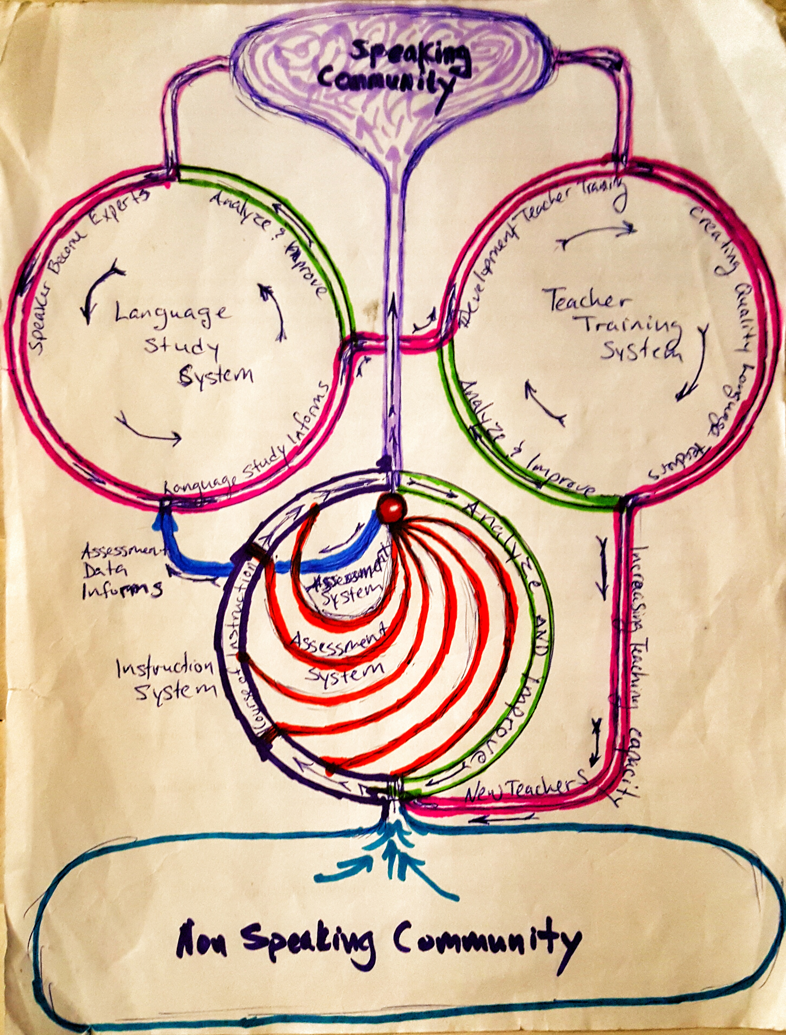
Speaking
Community
Non-Speaking Community

Slide 24
Teacher Training System
Well trained and experienced teachers efficiently facilitate the transfer and acquisition of the target language

Slide 25
The backbone of language transfer
How many teachers are needed?
At what levels are teachers needed?
Adult language teachers
  Build a bridge
  More teachers
  Community learning
Youth language teachers
  Language acquisition
  Academic instruction in language

Slide 26
Goals
Produce well trained and experienced language teachers
  That attain an education degree
  That attain a bilingual education degree
  That attain high level of proficiency in the language
To develop a well refined curriculum
Continuously assess and evaluate learning, teaching, course sequence and curriculum

Slide 27
Language Study System
In order to teach something effectively you need to have some knowledge of the subject.
In the case of language, you need to know the language in order to teach the language.

Slide 28
Assessment data analysis
Understanding the results of assessment data informs the effectiveness of instruction and the quality of curriculum.

Slide 29
Instruction or Curriculum
Learning gaps are identified through assessment.
Language study is essential in establishing sequence standards for curriculum developement
Curriculum standards create the matrix for which to evaluate and judge the sequence of instruction.
Learning gaps within curriculum standards indicate the instruction problems

Slide 30
Assessment informs instruction
The assessment system and language study system support instruction through the development and refinement of curriculum.
The evaluation of assessment data informs the refinement process of curriculum.
Assessment is used to measure the efficiency of the curriculum sequence
Assessment is used to measure the effectiveness of instruction

Slide 31
Instructional System
Language instruction is the prime activity of the language transfer system.

Slide 32
Instruction System Essentials
Non-speakers become speakers
Heart of the Language Transfer System
Continuously refined to increase efficiency
Teaching capacity must match community desire to learn the language
Teachers must be well supported and given sufficient time to recharge periodically
Efficient language instruction produces speakers in 12-24 months

Slide 33
Learning to Teach vs Learning to Speak
Language learners becoming teachers must
Acquire an advanced proficiency in the language
Become a part of the speaking community
Gain intimate knowledge of the language features
Understand the stages of language acquisition
Language learners becoming speakers
Acquire proficiency in the language
Become a part of the speaking community

Slide 34
Language Instruction/Learning Realities
In full immersion full-time it takes 12-24 months to learn a language with high oral proficiency.
Well trained and experienced teachers
Well developed learning sequence
Well developed assessment & evaluation system
Well developed teaching and learning tools

Slide 35
Effective and Efficient

Slide 36
Curriculum
The curriculum must be continuously refined and incorporate every new understanding of the language.
The curriculum sequence must be organized to scaffold learning in an increasingly efficient manner.
Assessment data must be continuously evaluated to find areas for curriculum improvement and instructional enhancement.

Slide 37
Speaking
Community
Non-Speaking Community

Slide 38
The speaking community

Slide 39
Elevate the language

Slide 40
Elevate the language
A diminished prestige of the language is the primary contributor of language loss.
Prestige needs to be re-instilled
Make speaking cool
Elevate the status of speakers
Create awards and recognition for speaking
Language competition can elevate the status
Parents need support and encouragement

Slide 41
Contact Potlatch Fund
www.potlatchfund.org or email info@potlatchfund.org
Call Seattle: 206-624-6076 or Spokane: 509-919-3046
Seattle Office
Dana Arviso, Executive Director, dana@potlatchfund.org Lawrence Leake, Managing Director, lawrence@potlatchfund.org
Tachini Pete, Program Director, tachini@potlatchfund.org
Mary Kummer, Office Manager, mary@potlatchfund.org
Damara Jacobs-Morris, Development & Communications Manager, damara@potlatchfund.org
Spokane Office
Maria Griffin, Program Coordinator, maria@potlatchfund.org

